Slide 1
Capstone Engagement
Assessment, Analysis, and Hardening of a Vulnerable System
By Andrew Christenson

Slide 2
Table of Contents
This document contains the following sections:
01
Network Topology
02
Red Team: Security Assessment
03
Blue Team: Log Analysis and Attack Characterization
Hardening: Proposed Alarms and Mitigation Strategies
04

Slide 3
Network Topology
‹#›

Slide 4
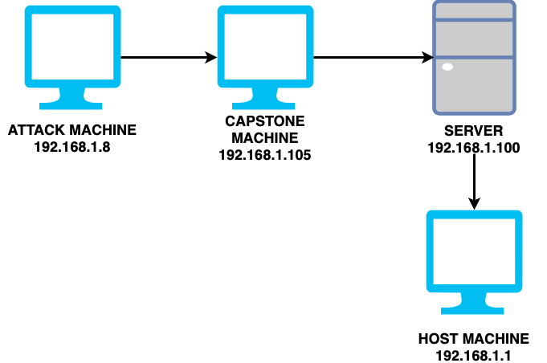
Network Topology
Network
Address Range: 192.168.1.0/24
Netmask: 255.255.255.0
Gateway: 10.0.0.76
Machines
IPv4: 192.168.1.1
OS: Windows 10
Hostname: Azure Hyper-V
IPv4: 192.168.1.100
OS: Linux
Hostname: ELK Stack
IPv4: 192.168.1.105
OS: Linux
Hostname: Capstone
IPv4: 192.168.1.90
OS: Linux
Hostname: Kali
90

Slide 5

Red Team
Security Assessment
‹#›

Slide 6
Recon: Describing the Target
Nmap identified the following hosts on the network:
Hostname | IP Address | Role on Network
Azure Hyper-V Machine | 192.168.1.1 | Host Machine
ELK Stack | 192.168.1.100 | Server monitoring machine
Capstone | 192.168.1.105 | Target Machine
Kali | 192.168.1.90 | Attack Machine

Slide 7
Vulnerability Assessment
The assessment uncovered the following critical vulnerabilities in the target:
Vulnerability | Description | Impact
Port 80 Open CVE-2019-6579 | Open entry to anyone trying to access the machine through port 80 | Folders and files can be viewed easily
LFI Vulnerability | LFI allows access into confidential files on a site | An LFI vulnerability allows attackers to gain access to sensitive credentials
Weak passwords and basic usernames | Usernames and passwords are just simple words and easily crackable | Folder and file access is attainable

Slide 8
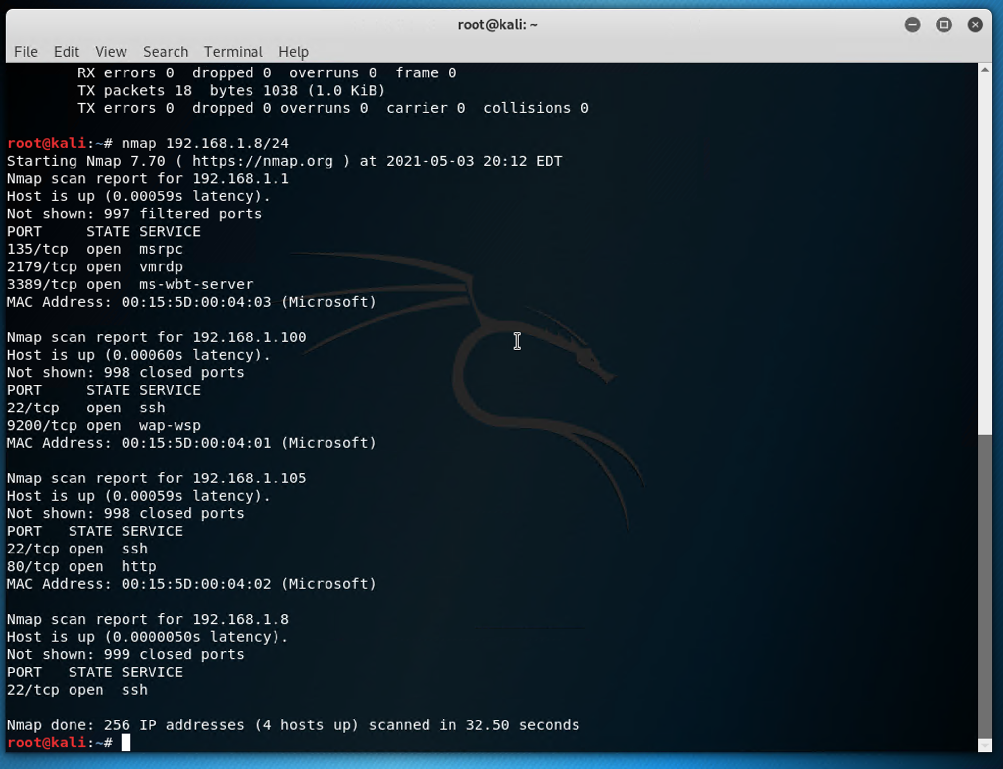
Exploitation: [Port 80 Open]
01
02
03
Tools & Processes
Utilized nmap to scan for open ports on the machine
Achievements
Discovered that ports 80 and 22 were open on the machine

Slide 9
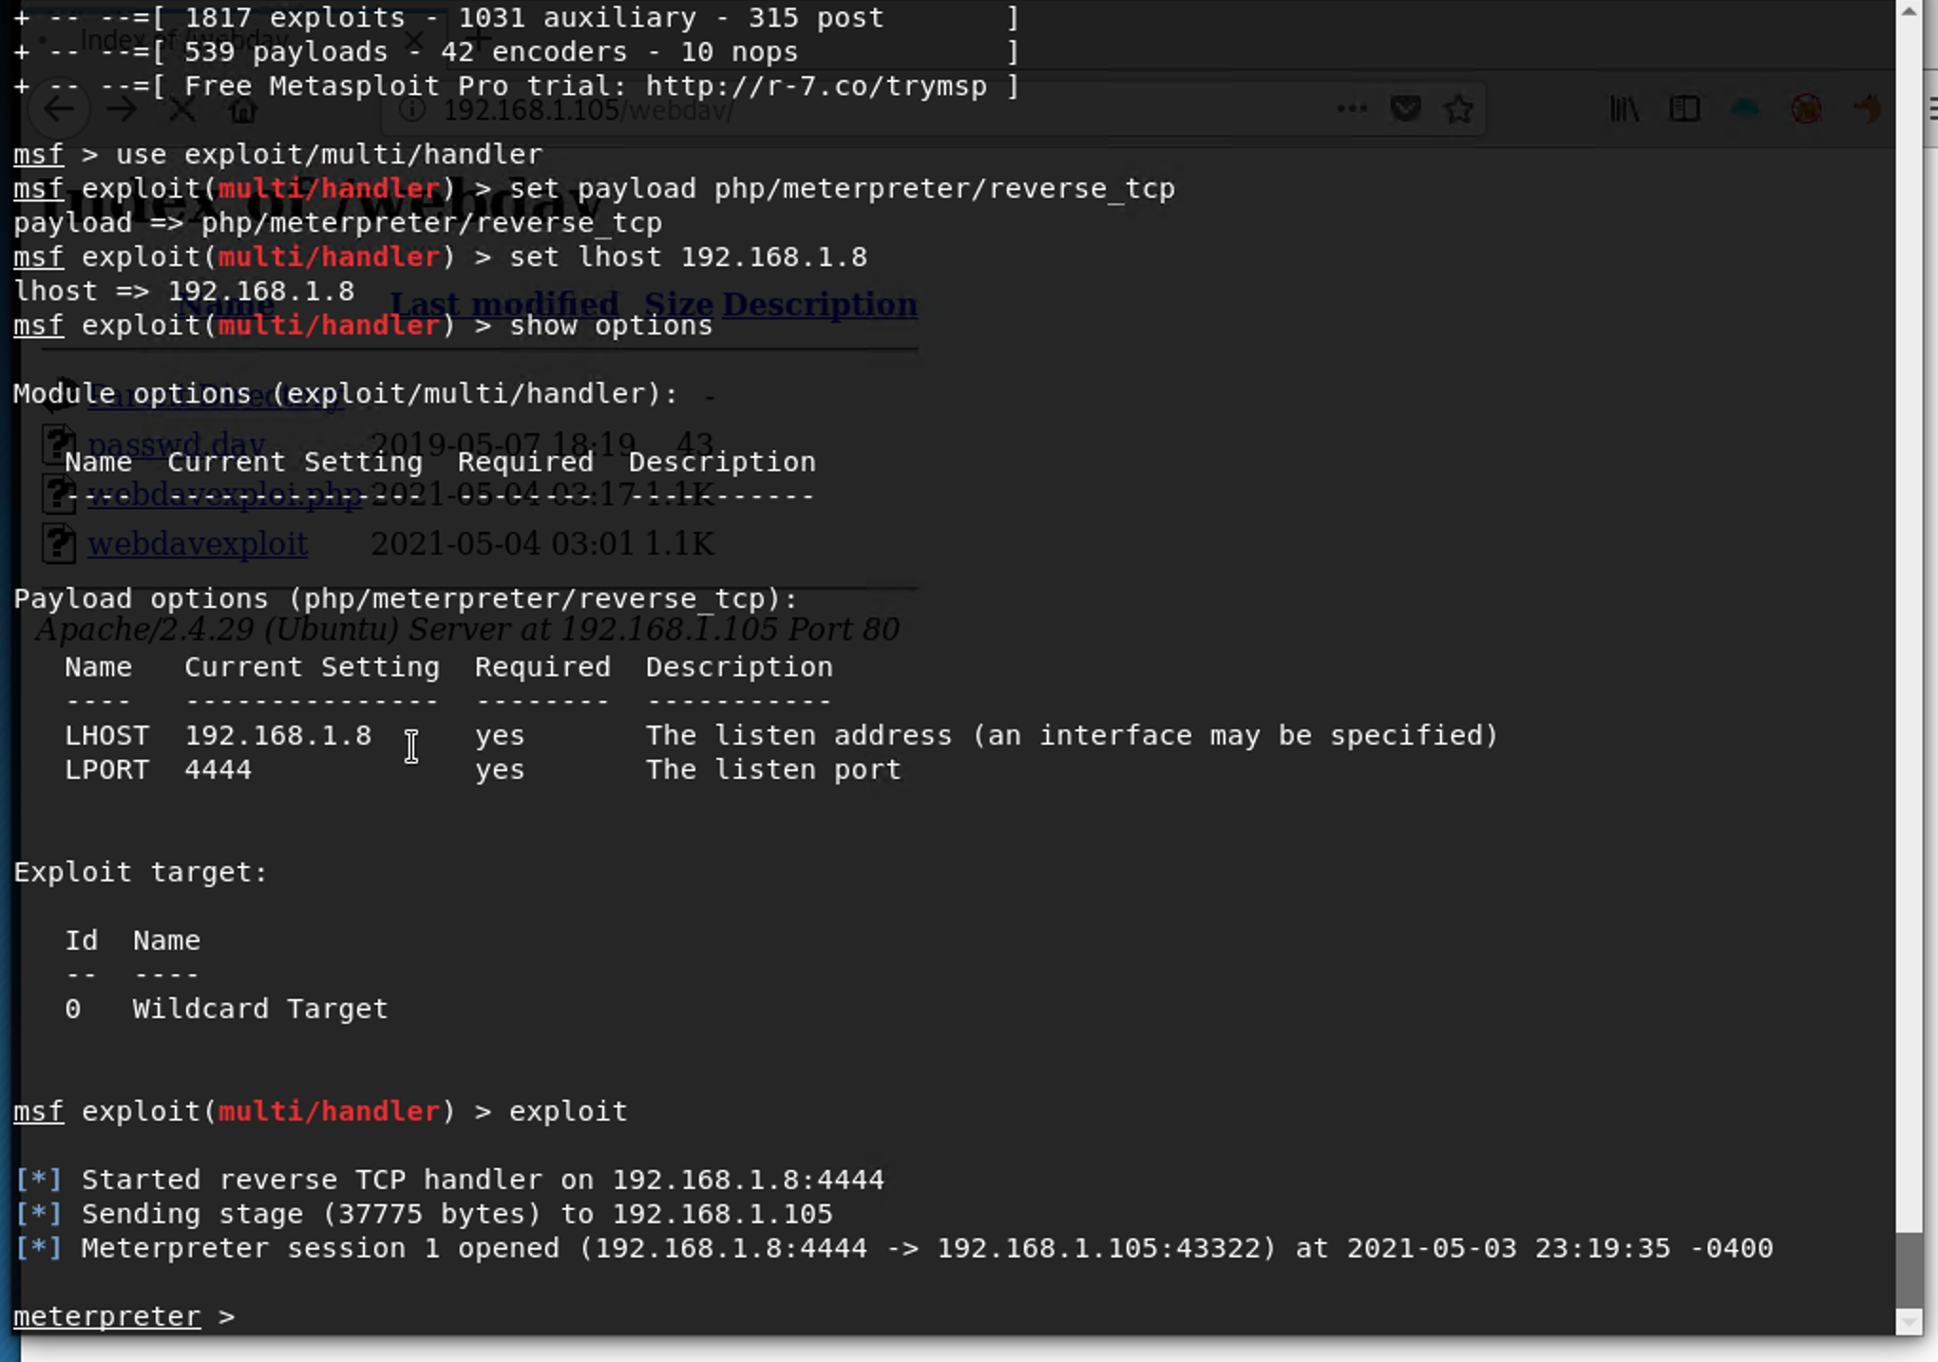
Exploitation: [LFI Vulnerability]
01
02
03
Tools & Processes
Utilized meterpreter and msfvenom to deliver payload to the machine
Achievements
Using the exploit gained access to the machine’s shell

Slide 10
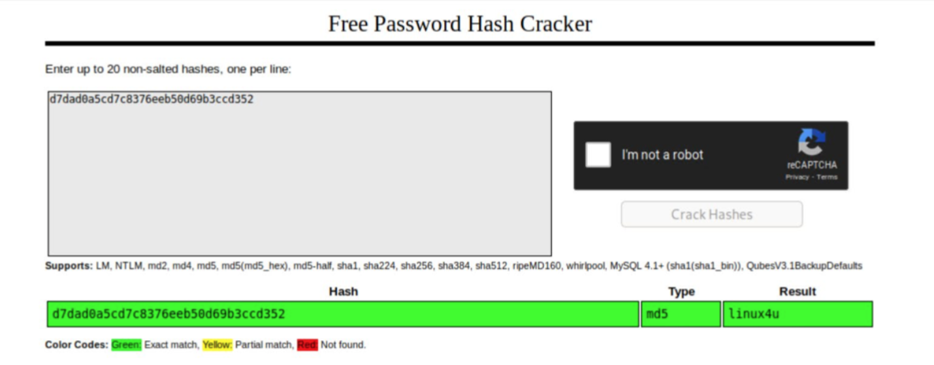
Exploitation: [Weak Passwords/Usernames]
01
02
03
Tools & Processes
Utilized crackstation.net to to crack the hashed password
Achievements
The password ‘linux4u’ was found for user Ryan

Slide 11

Blue Team
Log Analysis and Attack Characterization
‹#›

Slide 12

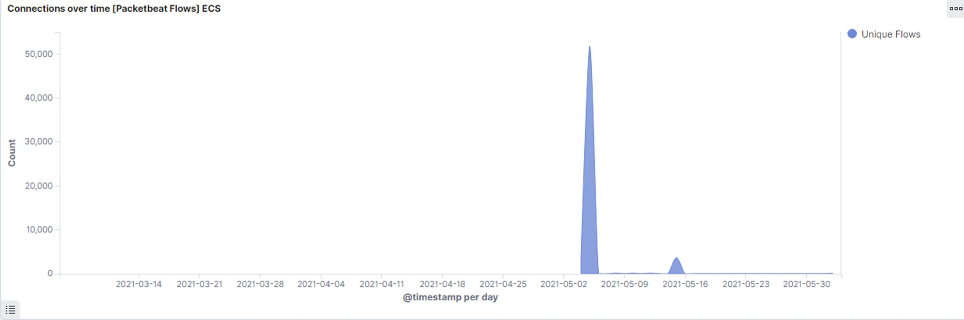
Analysis: Identifying the Port Scan
The port scan occurred on 05/05/2021 at 12:00 AM
51,807 requests were made from source IP 192.168.1.90
The spike in network traffic indicates this is a port scan

Slide 13
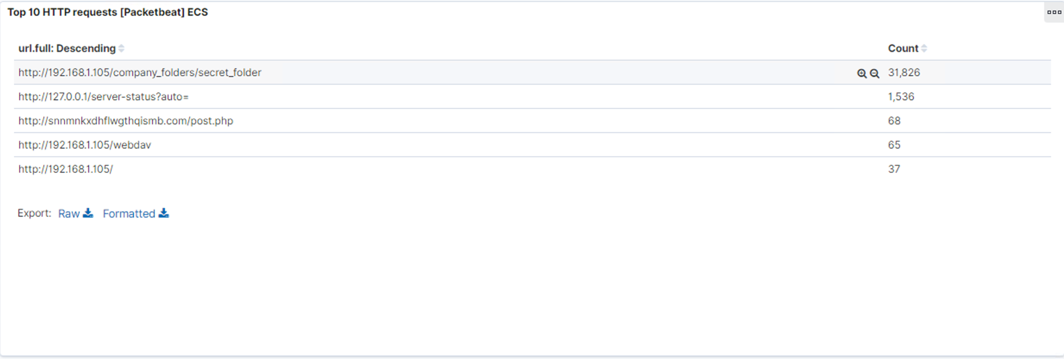
Analysis: Finding the Request for the Hidden Directory
31,826 requests were made at 12:00AM on 05/05/2021
The files in the /secret_folder were requested. They contained a password hash that was cracked to allow access to the machine

Slide 14
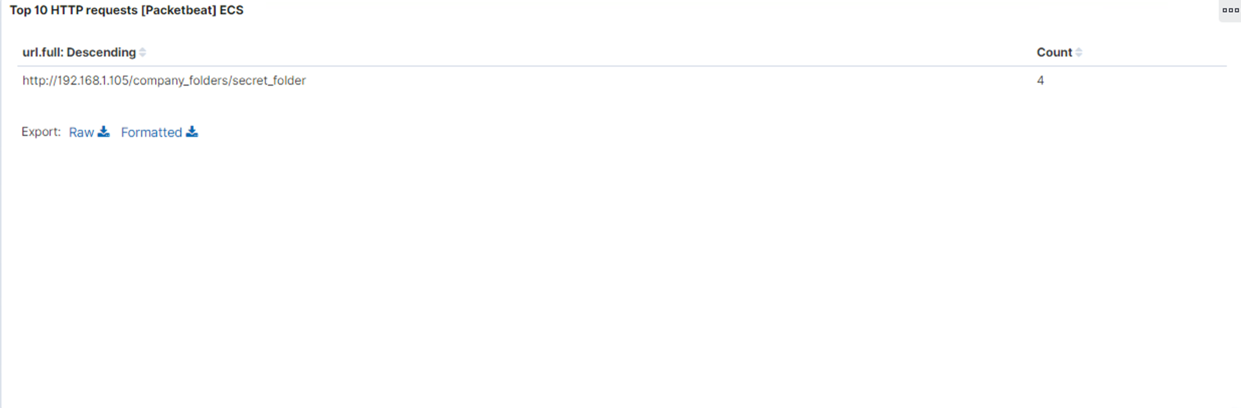
Analysis: Uncovering the Brute Force Attack
31,826 requests were made in the attack
4 requests were successful

Slide 15
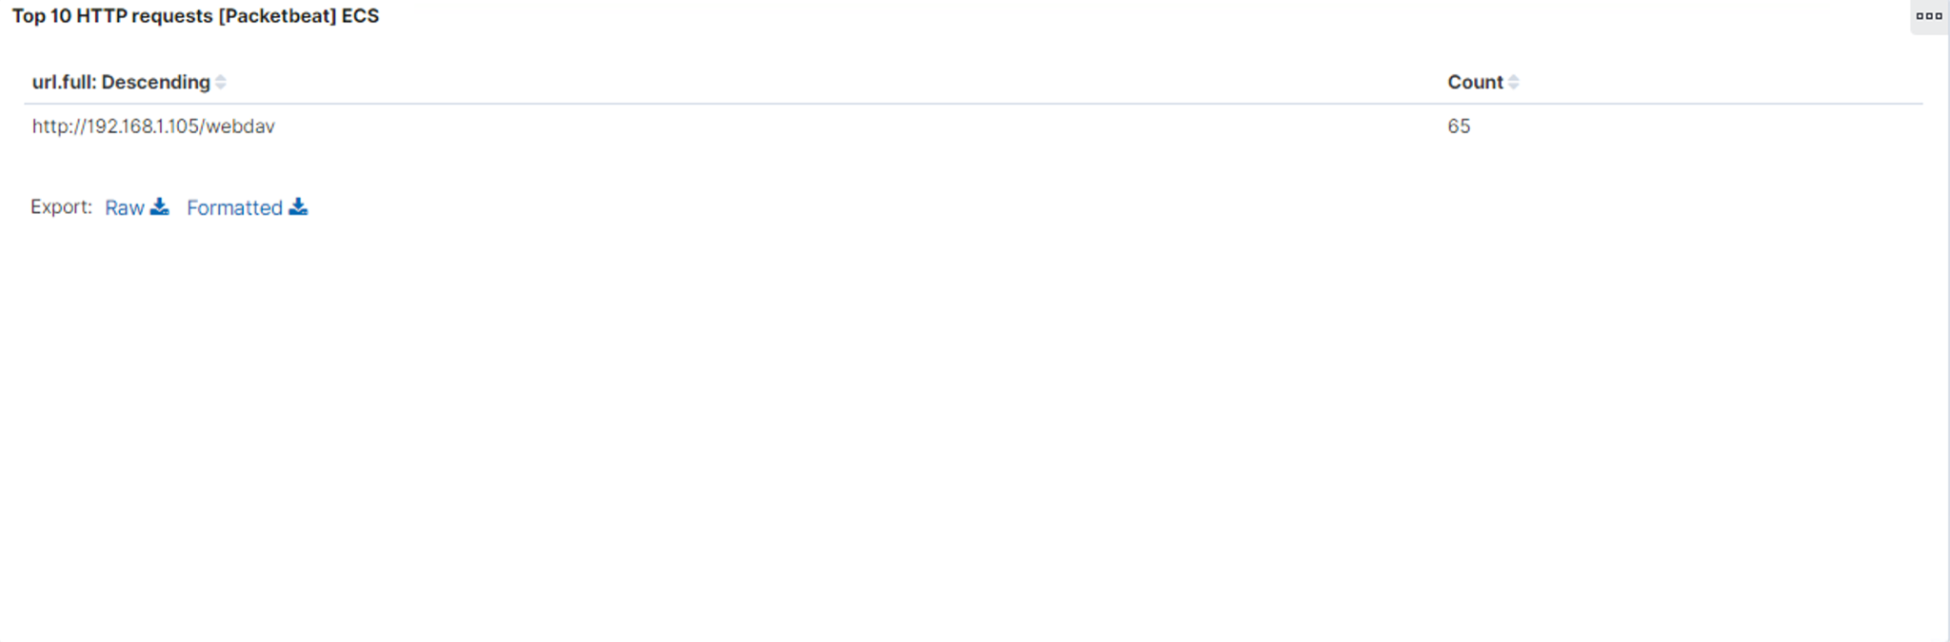
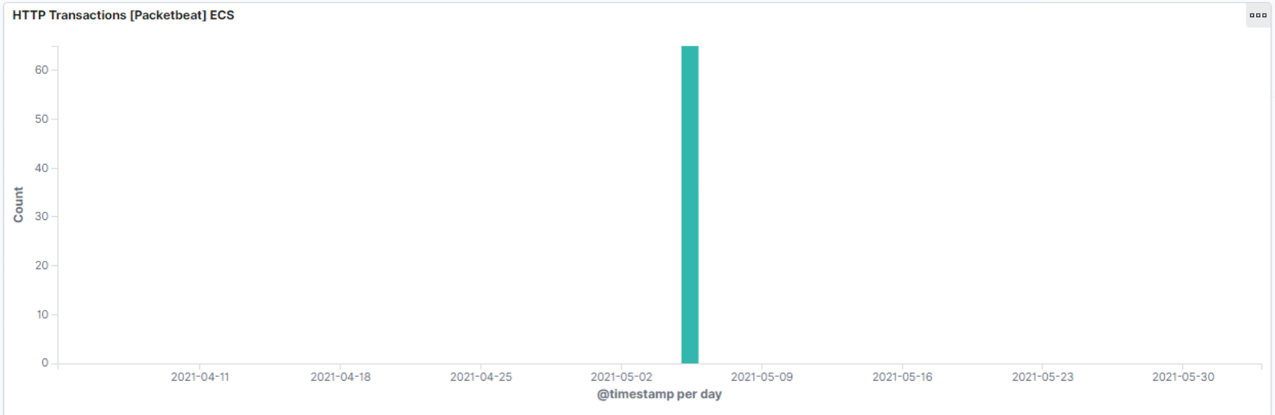
Analysis: Finding the WebDAV Connection
65 requests were made to the /webdav directory
The main files requested were shell.php and passwd.dav

Slide 16
Blue Team
Proposed Alarms and Mitigation Strategies
‹#›

Slide 17
Mitigation: Blocking the Port Scan
Set an alarm if the connections exceed 1000 in an hour
Patch the firewall so these connections are blocked
Perform regular system scans to detect and close any open ports

Slide 18
Mitigation: Finding the Request for the Hidden Directory
Set an alarm when access to the hidden directory is requested
Threshold of 10 requests per hour
Encrypt data
Whitelist only the acceptable IP addresses that can access this directory
Ensure share settings are restricted

Slide 19
Mitigation: Preventing Brute Force Attacks
Set an alarm when there are 400 level response codes returned at a threshold of 15 error codes
Lock out the user when 10 invalid login attempt are reached
Require more complex passwords

Slide 20
Mitigation: Detecting the WebDAV Connection
Create an alarm when IP addresses not on the whitelist attempt to access WebDAV
Configure a whitelist and harden the firewall if necessary

Slide 21
Mitigation: Identifying Reverse Shell Uploads
Set an alarm when any attempt is made to upload files
Close any unnecessary ports
Only allow whitelisted IP addresses
Set restrictive access controls

